Slide 1

Department Of Computer Science

Slide 2
Software Requirement Specification Speech2Face Application
Shahzaneer Ahmad
CUI/SP21-BCS-087/ISB
Shayan Zameer
CUI/SP21-BCS-088/ISB
Supervisor:
Mr. Tehseen Riaz Abbasi
Department Of Computer Science
Submission Date: 23rd Nov 2022

Slide 3
Project Category
The project categories are:
B- Web Application/Web Application based Information System
C- Problem Solving and Artificial Intelligence
E- Smartphone Application

Slide 4
Research Based Project
No, the project is not research based.

Slide 5
Introduction
The whole objective of this document is to cover all the details of speech2face application.
All the functionalities and requirements of software are described in detail. The document contain all the description of the tasks that can be performed while using application.
All the modules of system are explained in detail. The functional and non-functional requirements are provided in detail. This documents helps all the stakeholders that are involved in this project.

Slide 6
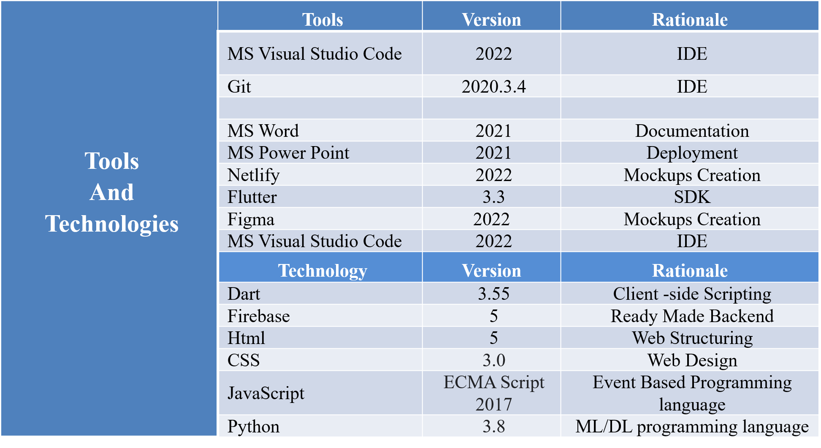
Tools and Technologies
The tools and technologies that will be used in the project are provided in the table below

Slide 7
Scope
The application will be designed to provide coordination among the User and Security Person.
Profile Management: The users will have to register and then sign into the system to use it. His record will be saved against his ID.
Chat bot: There is an intelligent chatbot that will help the user to get started with the application and will guide about usage.
Post-Voice record Management: The user can record voice, add previously existing voice , update it and delete it. It will be analyzed by the ML model.
Vector to Vector Model: The voice is the extracted and converted to the vector model with the help of machine learning and AI.
Vector Model to Vector-Image Model: The generated vector model is taken as input for this module and It is converted to image form using the power of AI.
Help and Support: User’s queries will be resolved through an AI bot and If it is unable to resolve query then user will have option to live chat with the support team.

Slide 8
Scope
Review Module: As the project is R & D based therefore it is not 100% possible for the system to detect the correct insights. Therefore, the system will prompt the user to give his feedback and it will improve itself according to the reviews given by users.
Insights Module: It Opens a page to the insights that are obtained by the voice notes including predicted age, race, nose type, facial features details, etc.

Slide 9
Modules
The modules of the project are listed below:
Module 1: Profile Management
Module 2: Place Voice Record
Module 3: Sound to Face Vector Model
Module 4: Face-Vector to Face-Image Model
Module 5: Image View Customization
Module 6: Features Enhancer.
Module 7: Insight Panel
Module 8: Feedback panel
Module 9: Help and Support

Slide 10
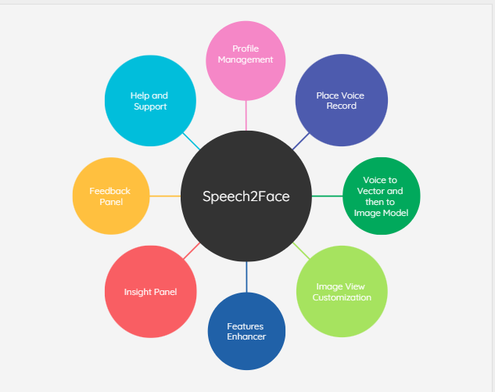
Context Diagram of Proposed Project
Context Diagram

Slide 11
Requirement Elicitation Techniques
The requirement elicitation techniques are given below:
Observations.
Group discussion.
Studying related systems.
Questionnaires and Surveys.

Slide 12
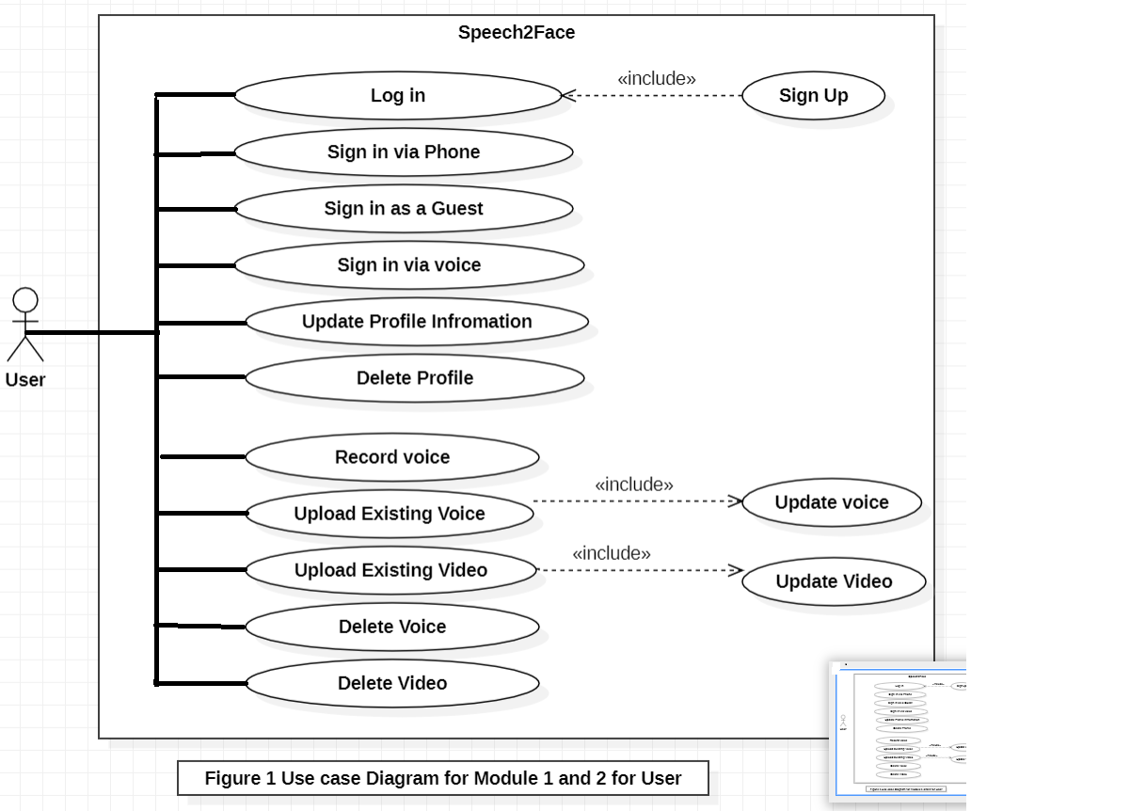
Use Case Diagram For Users

Slide 13
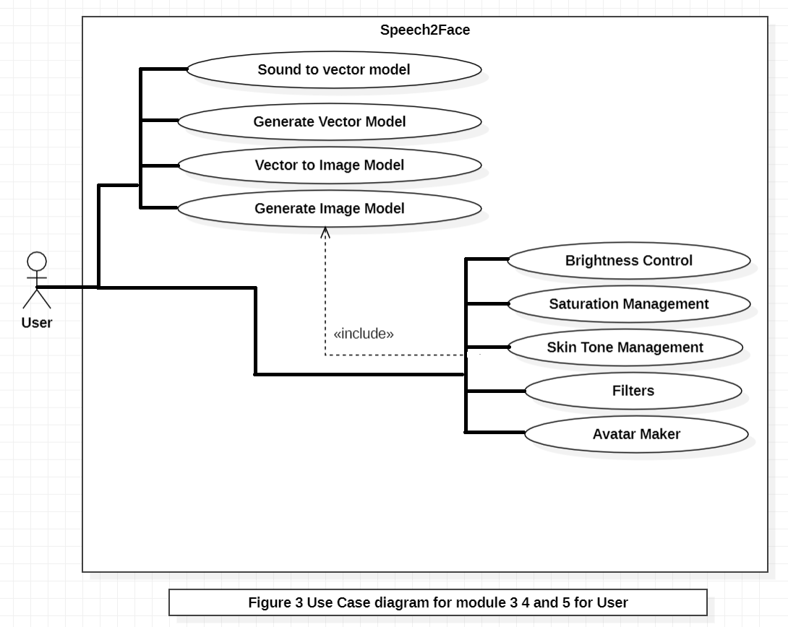
Use Case Diagram For Users

Slide 14
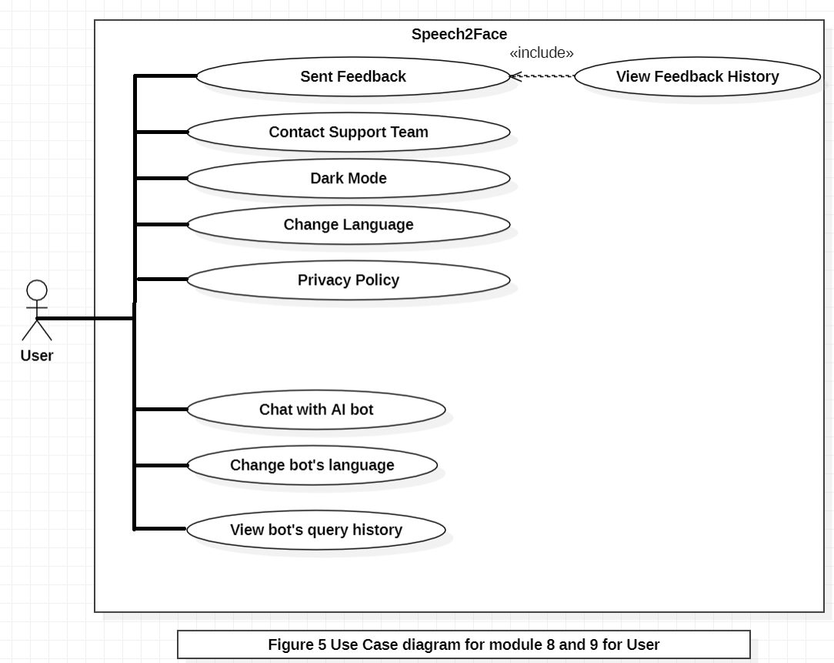
Use Case Diagram For Users

Slide 15
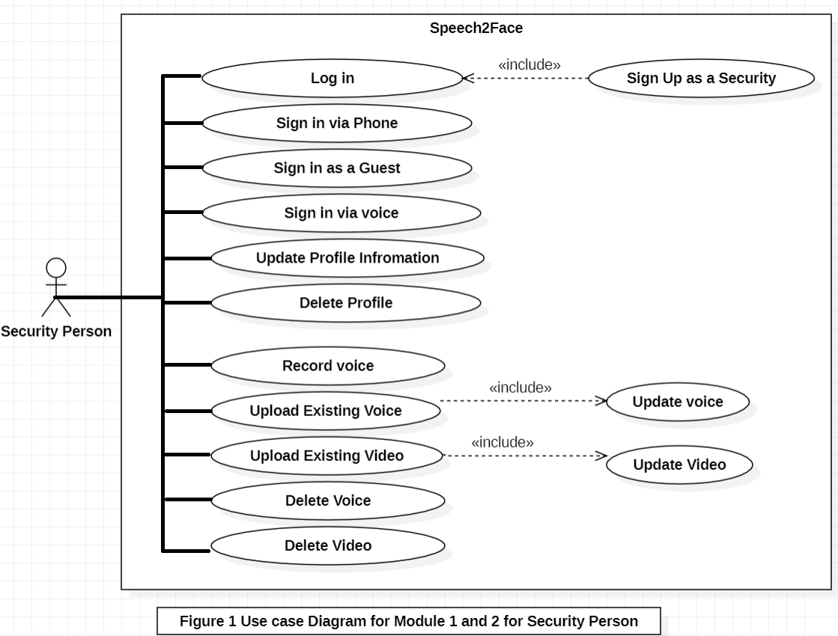
Use Case Diagram For Security Person

Slide 16
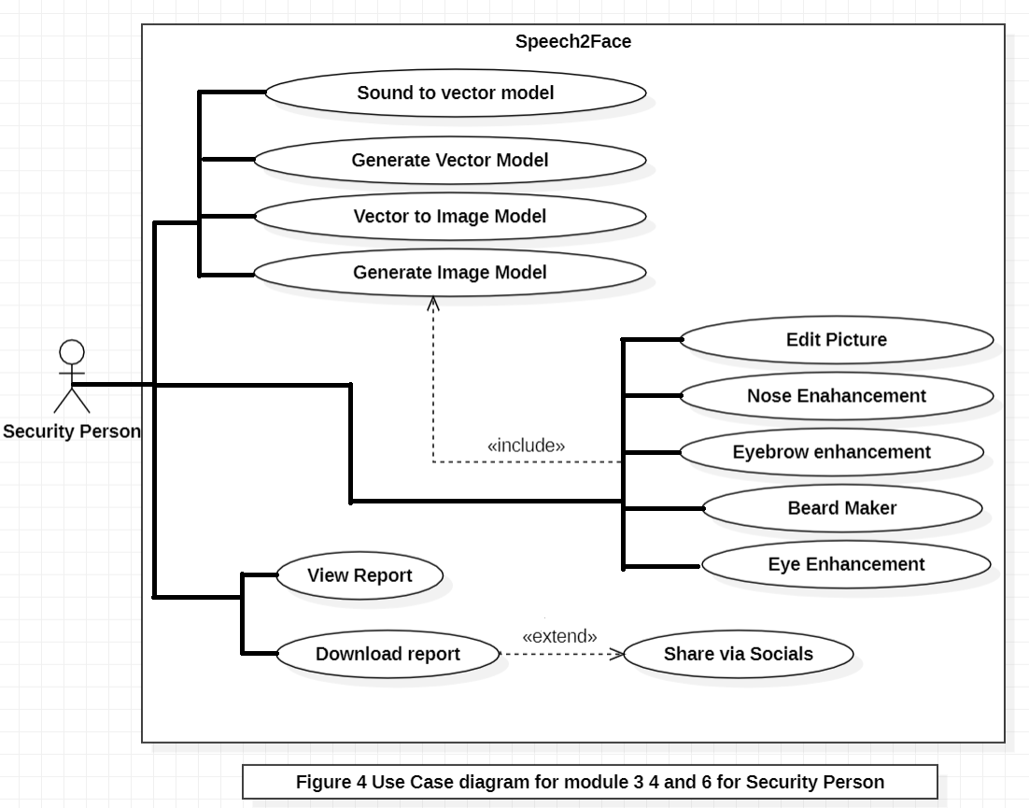
Use Case Diagram For Security Person

Slide 17
List of Use Cases Module Wise Module-1: Profile Management
Module 1: Profile Management (Tabular Module 1.pdf)
Use Case Id | Use Case Title | Use Case Description | Functional Requirement
UC-1.1 | Signup | Users will have to create an account first | M1_UC1.pdf
UC-1.2 | Login | The users will log in to their accounts when they want to use it. | M1_UC2.pdf
UC-1.3 | Sign in via phone | User can sign in by using their phone. | M1_UC3.pdf
UC-1.4 | Sign in via voice | User can sign in by using their voice. | M1_UC4.pdf
UC-1.5 | Update Profile | User can update their profile. | M1_UC5.pdf

Slide 18
List of Use Cases Module Wise Module-1: Profile Management
Module 1: Profile Management (Tabular Module 1.pdf)
Use Case Id | Use Case Title | Use Case Description | Functional Requirement
UC-1.6 | Log out | User Can logout of their account | M1_UC6.pdf

Slide 19
List of Use Cases Module Wise Module-2: Place a Voice record
Module 2: Place a Voice Record
Use Case Id | Use Case Title | Use Case Description | Functional Requirement
UC-2.1 | Record voice | The user can record their voice. | M2_UC1.pdf
UC-2.2 | Upload Existing voice | The users can Upload existing voice. | M2_UC2.pdf
UC-2.3 | Upload Existing Video | The user can Upload existing video through which voice can be extracted. | M2_UC3.pdf
UC-2.4 | Update voice | The user has option to update voice. | M2_UC4.pdf
UC-2.5 | Update video | The user has option to update video. | M2_UC5.pdf
UC-2.6 | Delete Voice | Users can delete voices from saved voices folder. | M2_UC6.pdf
UC-2.7 | Delete Video | User can delete existing videos from saved video folder. | M2_UC7.pdf

Slide 20
List of Use Cases Module Wise Module-3: Sound to Vector Model
Module 3: Sound to Face Vector Model
Use Case Id | Use Case Title | Use Case Description | Functional Requirement
UC-3.1 | Sound to Vector via deep learning | In this use case voice will be converted to vector model usin Machine learning. | M3_UC1.pdf
UC-3.2 | Generate Vector Model | The Vector model can be generated | M3_UC2.pdf

Slide 21
List of Use Cases Module Wise Module-4: Vector to Image Model
Module 4: Vector to Image Model
Use Case Id | Use Case Title | Use Case Description | Functional Requirement
UC-4.1 | Vector to Image model via deep learning | In this use case vector will be converted to image model using Machine learning. | M4_UC1.pdf
UC-4.2 | Generate Image | The image can be generated | M4_UC2.pdf

Slide 22
List of Use Cases Module Wise Module-5: Image View Customization
Module 5: Image View Customization
Use Case Id | Use Case Title | Use Case Description | Functional Requirement
UC-5.1 | Brightness Control | User can control the brightness of image. | M5_UC1.pdf
UC-5.2 | Saturation Management | User can adjust saturation to image. | M5_UC2.pdf
UC-5.3 | Skin tone Management | User can adjust skin tone of image. | M5_UC3.pdf
UC-5.4 | Filters | User can apply filters to image. | M5_UC4.pdf
UC-5.5 | Avatar maker | User can make avatar. | M5_UC5.pdf

Slide 23
List of Use Cases Module Wise Module-6: Features Enhancement
Module 6: Features Enhancement
Use Case Id | Use Case Title | Use Case Description | Functional Requirement
UC-6.1 | Edit Picture | Security person can edit image. | M6_UC1.pdf
UC-6.2 | Nose Enhancement | Security person can enhance Nose. | M6_UC2.pdf
UC-6.3 | Eye Enhancement | Security person can enhance eye. | M6_UC3.pdf
UC-6.4 | Eyebrow Enhancement | Security person can enhance eyebrow. | M6_UC4.pdf
UC-6.5 | Beard Maker | Security person can make beard of person. | M6_UC5.pdf

Slide 24
List of Use Cases Module Wise Module-7: Insight Panel
Module 7: Insight Panel
Use Case Id | Use Case Title | Use Case Description | Functional Requirement
UC-7.1 | View report | Security person can view report. | M7_UC1.pdf
UC-7.2 | Download report | Security Person can download report. | M7_UC2.pdf
UC-7.3 | Share via Socials | Security person can share reports to social. | M7_UC3.pdf

Slide 25
List of Use Cases Module Wise Module-8: Help And Support
Module 8: Help And Support
Use Case Id | Use Case Title | Use Case Description | Functional Requirement
UC-8.1 | Chat With AI Bot | Users can chat with bot to get instant automated answers. | M8_UC1.pdf
UC-8.2 | Contact Support Team | Users can contact support team. | M8_UC3.pdf
UC-8.3 | Change Bot’s Language | Users can change bot language including Urdu and English. | M8_UC5.pdf
UC-8.4 | View Bot Query History | The user will be able to view the history of their queries with the bot. | M8_UC6.pdf

Slide 26
List of Use Cases Module Wise Module-9: Settings and Configuration
Module 8: Settings and Configuration
Use Case Id | Use Case Title | Use Case Description | Functional Requirement
UC-9.1 | Sent Feedback | Users can chat with bot to get instant automated answers. | M9_UC1.pdf
UC-9.2 | Contact Support Team | Users can contact support team. | M9_UC2.pdf
UC-9.3 | View Feedback History | Users can see the history of feedbacks sent by the user. | M9_UC3.pdf
UC-9.4 | Dark mode | The user will be able to apply dark mode on application | M9_UC4.pdf

Slide 27
List of Use Cases Module Wise Module-9: Settings and Configuration
Module 8: Settings and Configuration
Use Case Id | Use Case Title | Use Case Description | Functional Requirement
UC-9.5 | Change Language | Users can change the language of application. | M9_UC5.pdf
UC-8.2 | Privacy Policy | Users can read the privacy policy of the system. | M9_UC6.pdf

Slide 28
Non-Functional Requirement
The Non-Functional Requirements are provided below:
Title | Performance Requirements
NFR-1 | The system will have a minimum response time of 1.5 second and maximum response time of 5 seconds. After reaching 5 seconds limit, user will receive a prompt message and previous activity will be restored.
Title | Reliability
NFR-2 | MTBF (Mean Time between Failures): The estimated mean time between failures will be 24 hours ÷ 4 Errors. So, the estimated MTBF value is 6. Consequences of the Software Failure: Even if the software fails due to an error, the user will not lose his/her data. Every detail of the user’s data will be recovered because the backup system of software will always update the backup file after every change the user made in his/her profile. So incase the system fails, the backup program will execute automatically to recover all the data. Protection from Failure: At the testing phase of the Software development, the software would be thoroughly checked before going on to the next phase. So, there would be a 10% chance that an error could be faced by any user. Strategy for Correction: As the design methodology that will be used is Object Oriented, so even if the error shows up, it will be easier to detect the line of code where the bug is present. So, the average time to fix an error would be 3-4 hours.

Slide 29
Non-Functional Requirement
Titles | Usability
NFR-3 | Use-1: A new user of the software will take only 20-30 minutes to understand the use of the system. Use-2: The software will be easy to use, and the users will not have to add their credentials again and again because the credentials will be saved when the user adds them for the first time on choice. Use-3: The interface of the system will also be easy to use. Users can easily switch menus and understand it without any problem because every menu has a simple interface. Use-4: The lost data of the user can be recovered through the backup system. The probability of data recovery is 90%.
Title | Security
NFR-4 | The system will ensure the security of data and information of users. The credentials of Users are safe.

Slide 30
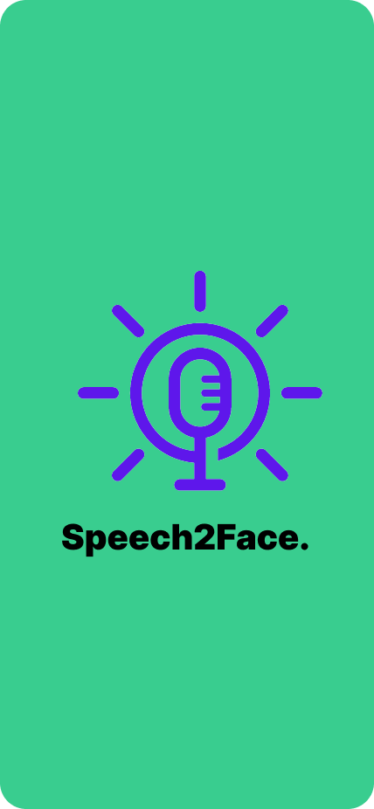
User Interfaces
Interface-1: Splash Screen of Mobile application

Slide 31
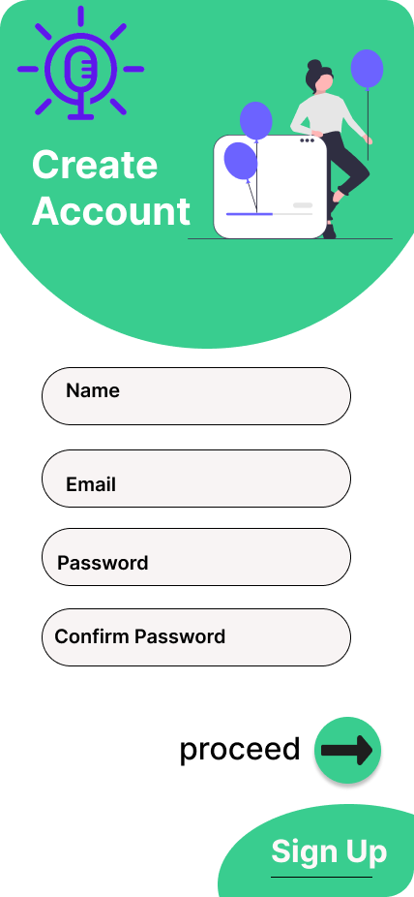
User Interfaces
Interface-2: Signup Screen of Mobile application

Slide 32
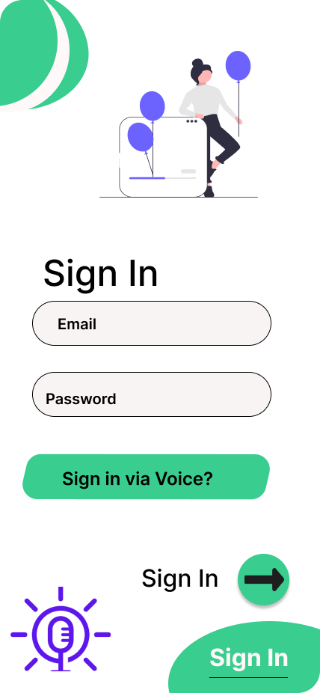
User Interfaces
Interface-3: Sign in Screen of Mobile application

Slide 33
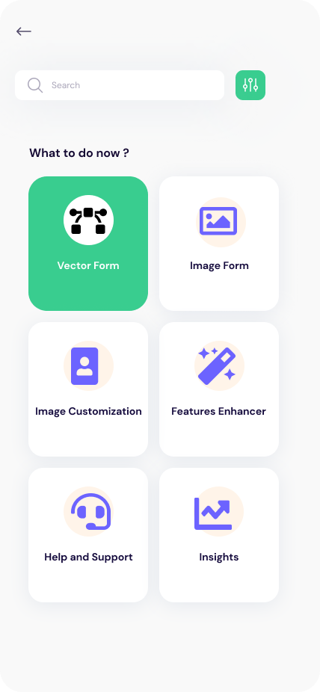
User Interfaces
Interface-4: Home Screen of Mobile application

Slide 34
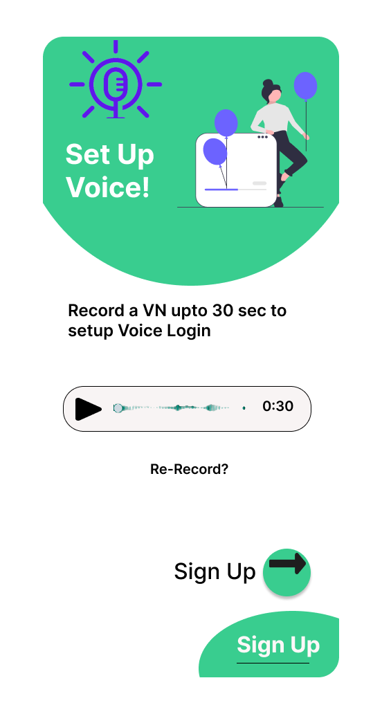
User Interfaces
Interface-5: Add Voice Screen of Mobile application

Slide 35
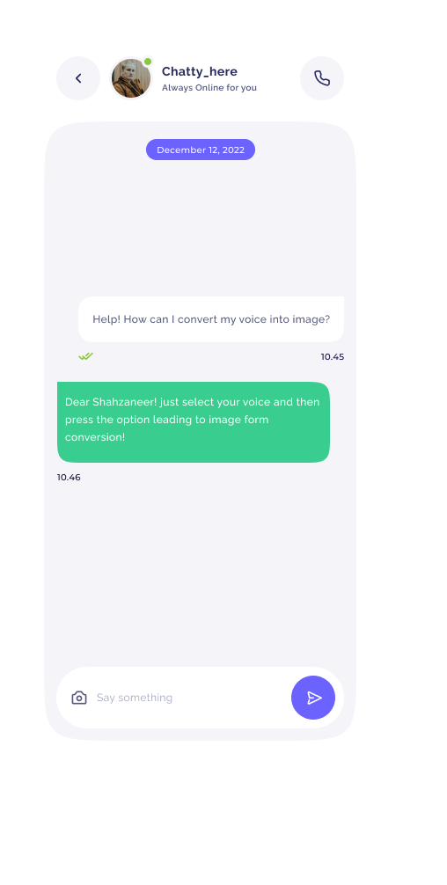
User Interfaces
Interface-6: Chat Box Screen of Mobile application

Slide 36
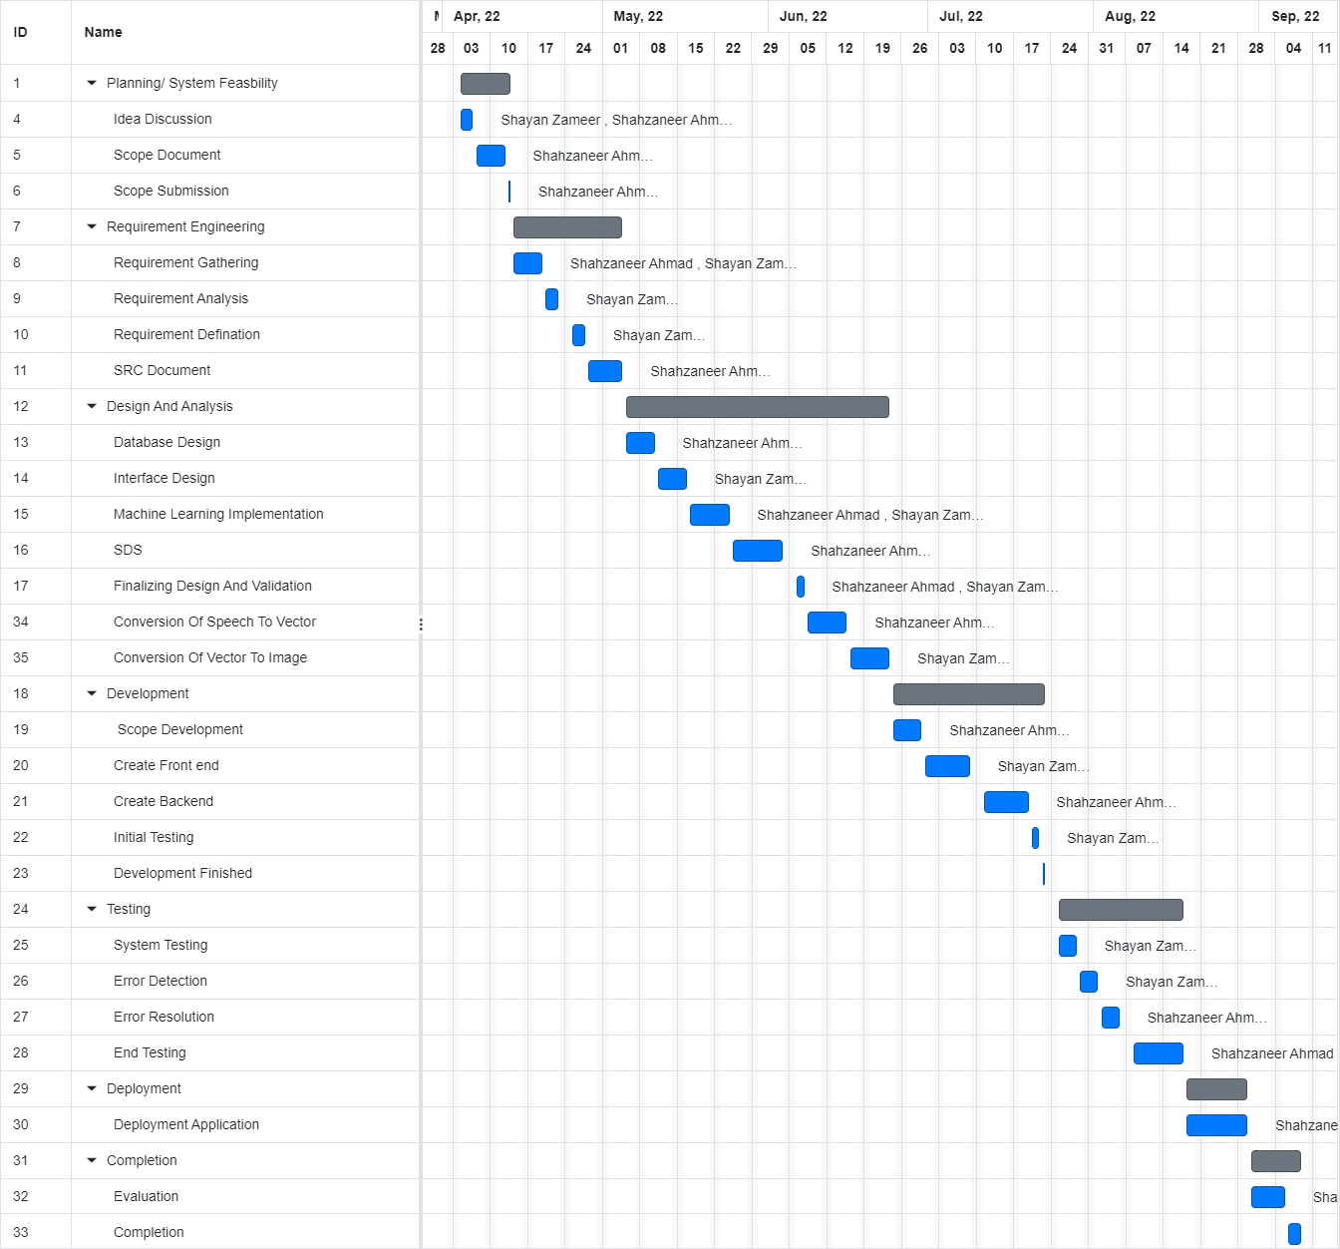
Gantt Chart
Gantt Chart is provided Below:

Slide 37
Conclusion
The SRS document portrays the final product of the project.
The Functional and Non-Functional Requirements of the system are stated in detail.
The document explains and quantifies Non-Functional Requirements.
The document also portrays interface mockups which will be developed in the future.
It is the ultimate guideline for all the stakeholders involved in the project.
This SRS document is the first step into the development phase of the project.

Slide 38
References
Related Systems:
https://www.github.com/topics/sound-classification.
https://speech2face.github.io/
Google Facenet
Youtube Resources:
https://www.youtube.com/watch?v=aKYlSIs3UDY&t=334s

Slide 39

Questions and Answers

